Slide 1
Chapter 11-2: buffer cache
Chapter 3 of
  《the Design of the UNIX Operating System》
structure
getblk
brelse
bread
breada
bwrite

Slide 2
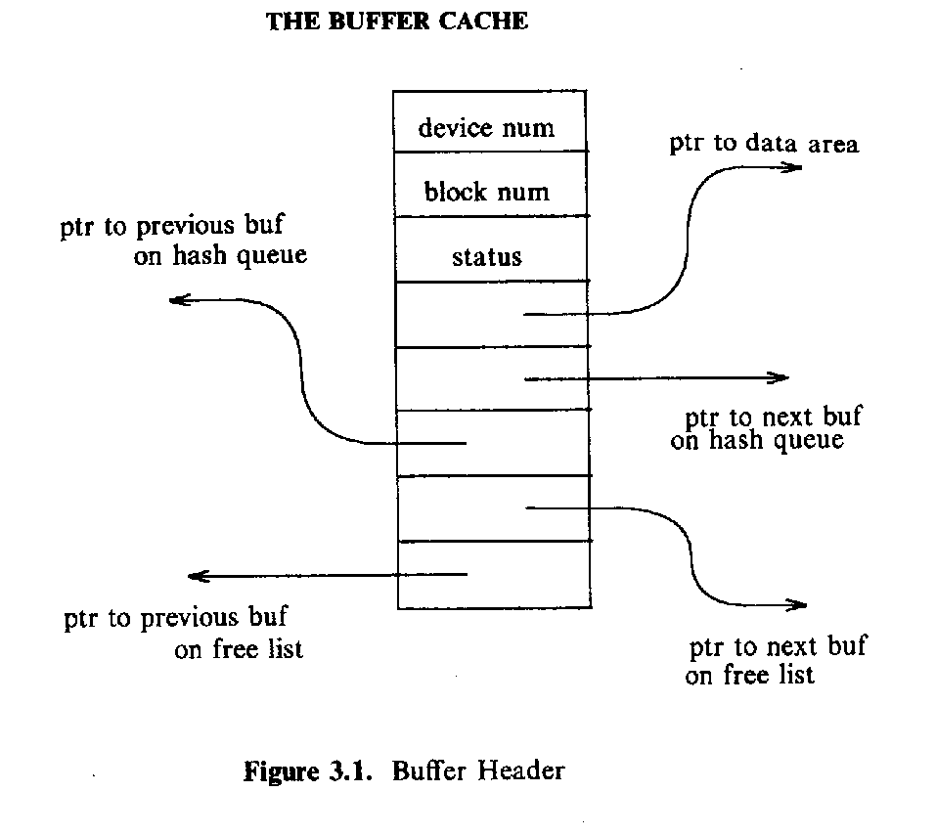
the buffer header

Slide 3

the status of the buffer

Slide 4
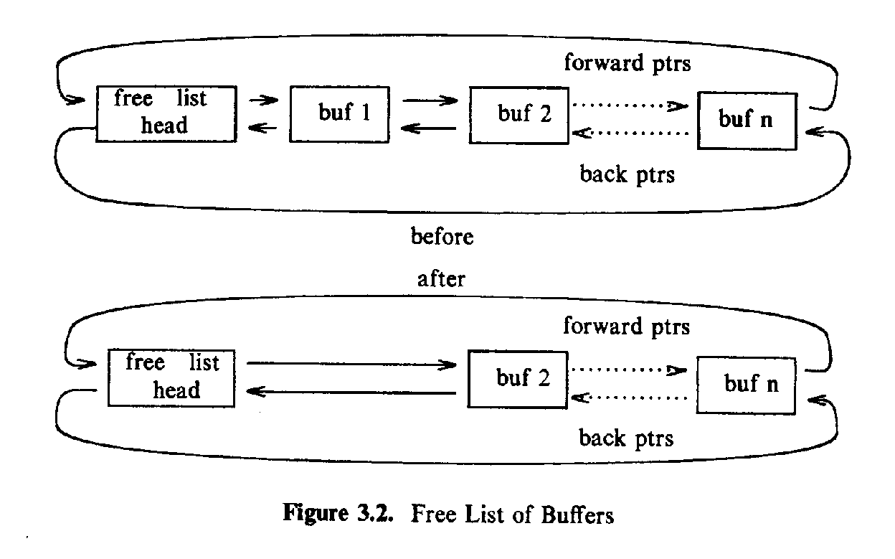
the buffer list

Slide 5
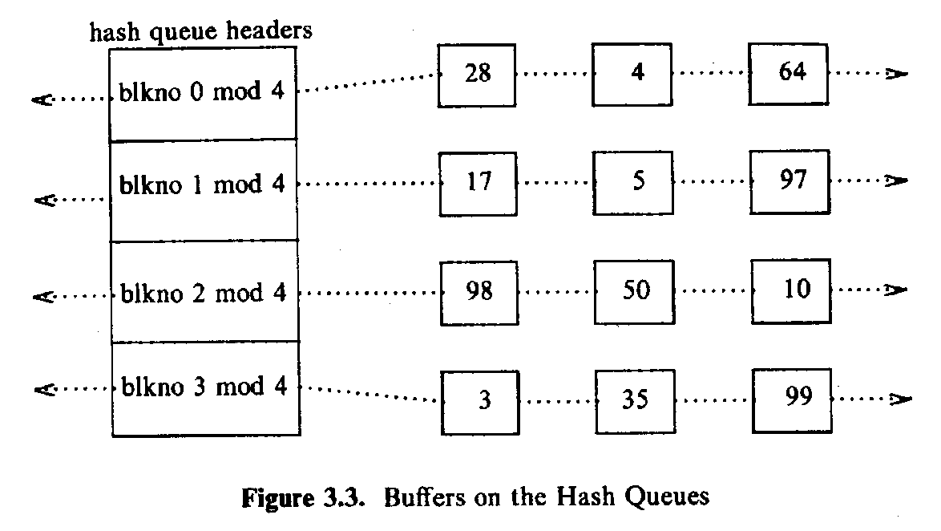
buffers on the hush queues

Slide 6
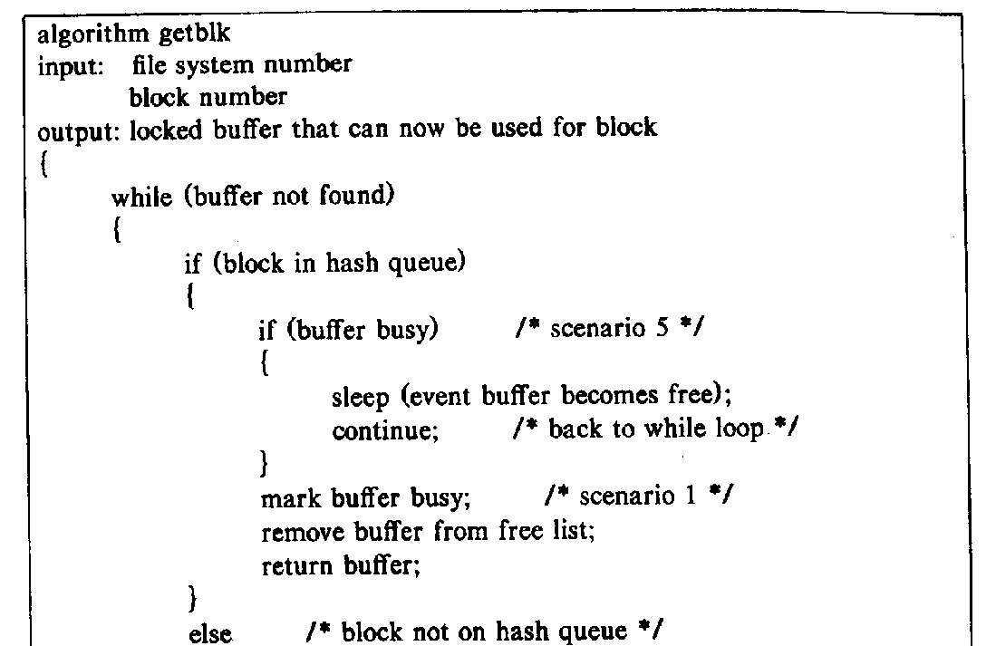
algorithm getblk

Slide 7
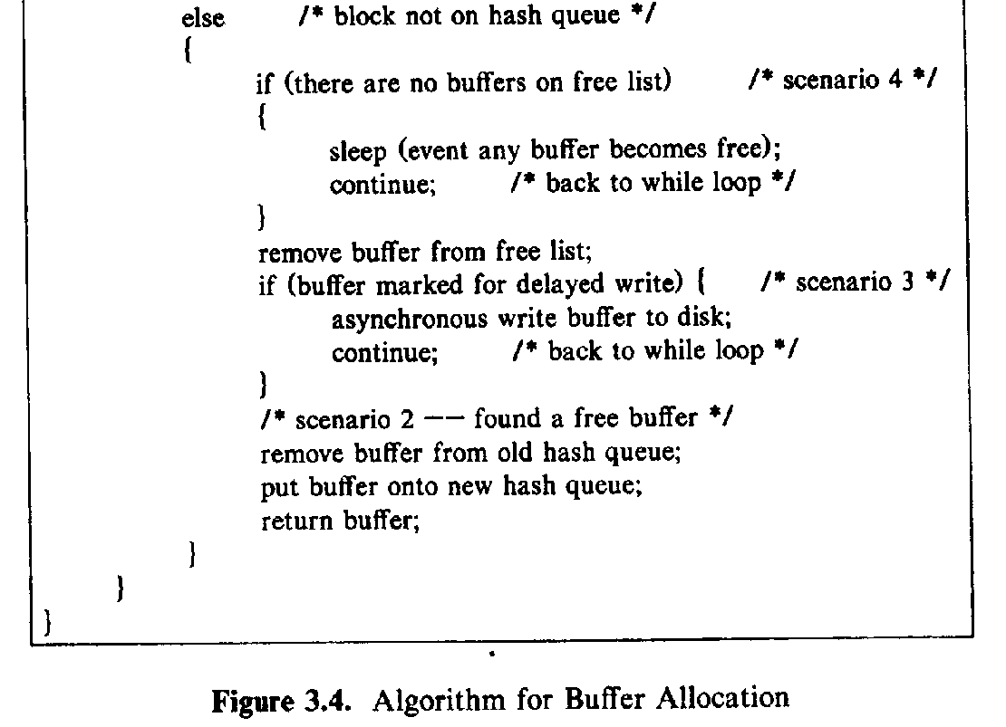
algorithm getblk(cont.)

Slide 8
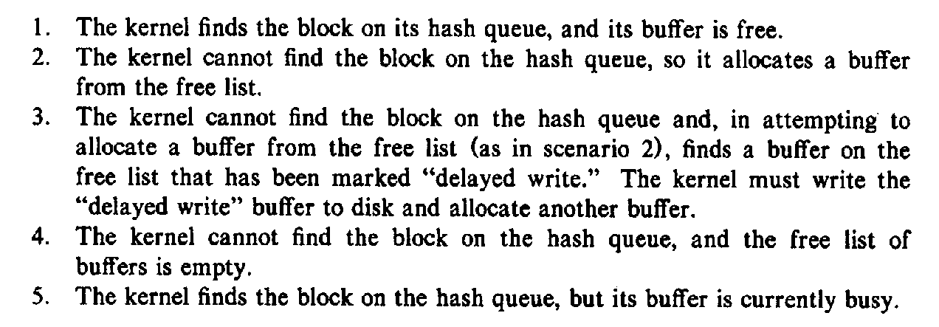
scenarios of getblk

Slide 9
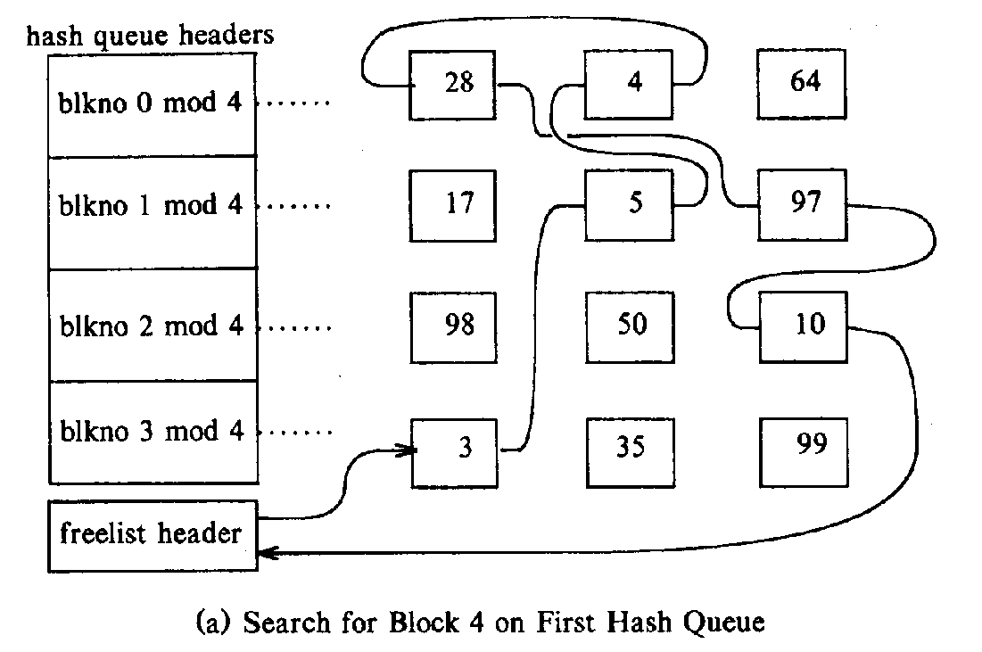
1. find the block in a hush queue

Slide 10
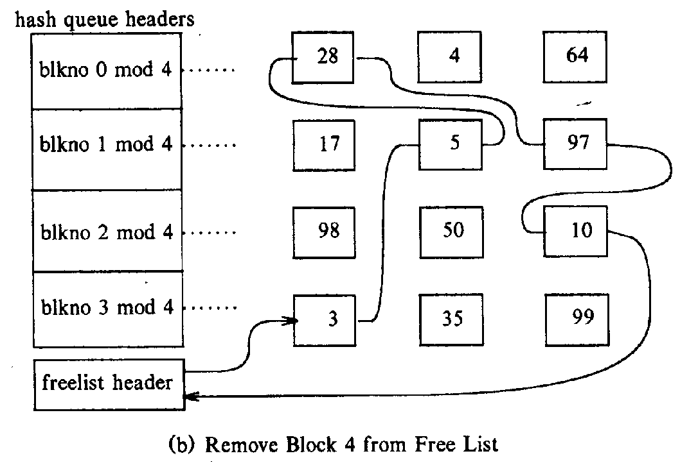
1. find the block in a hush queue

Slide 11
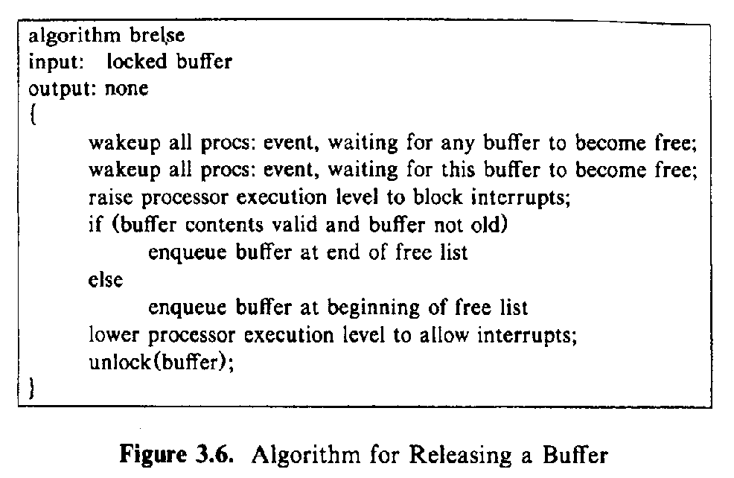
algorithm brelse

Slide 12
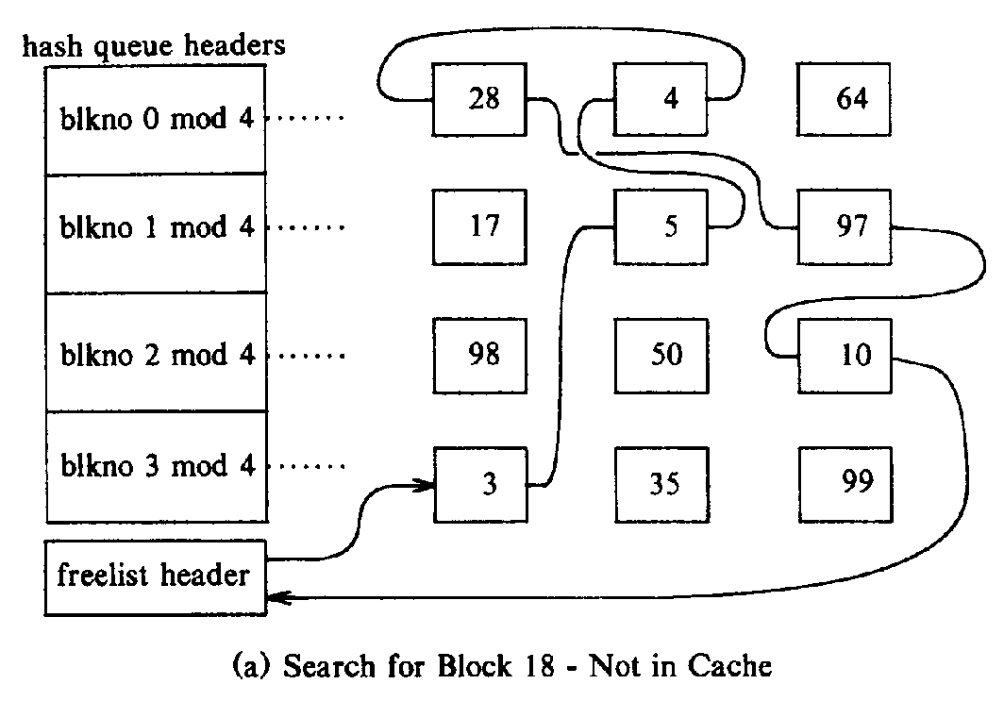
2 block not find in cache

Slide 13
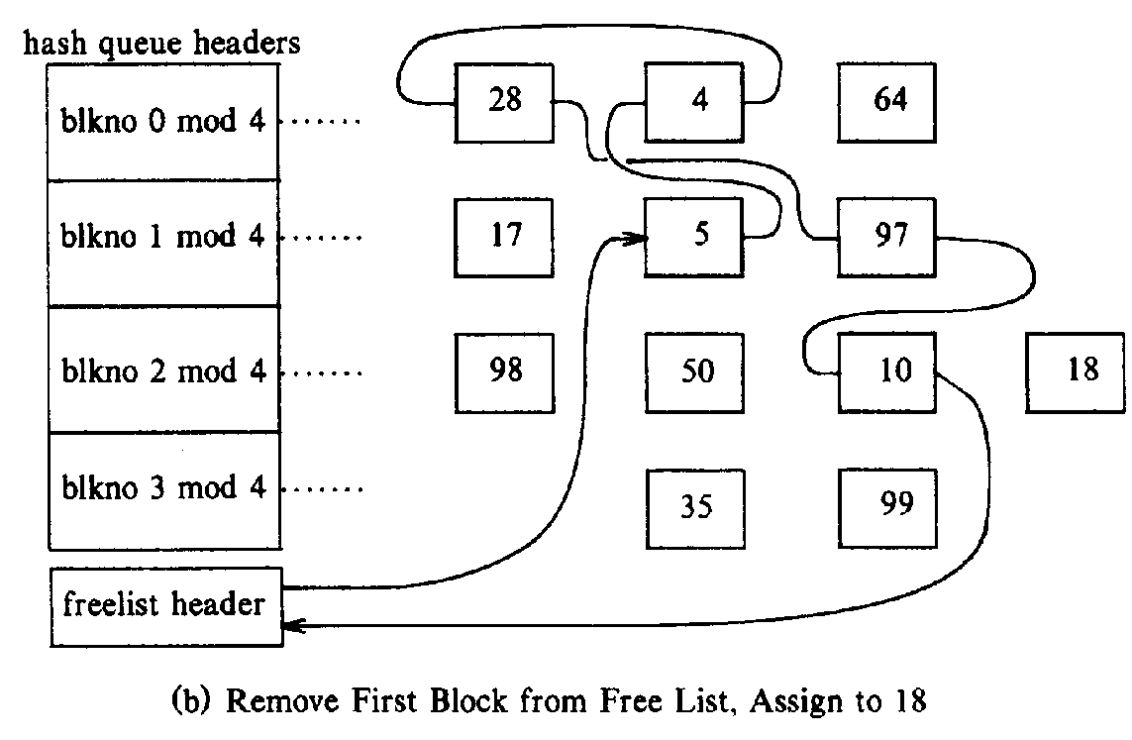
2 block not find in cache(cont.)

Slide 14
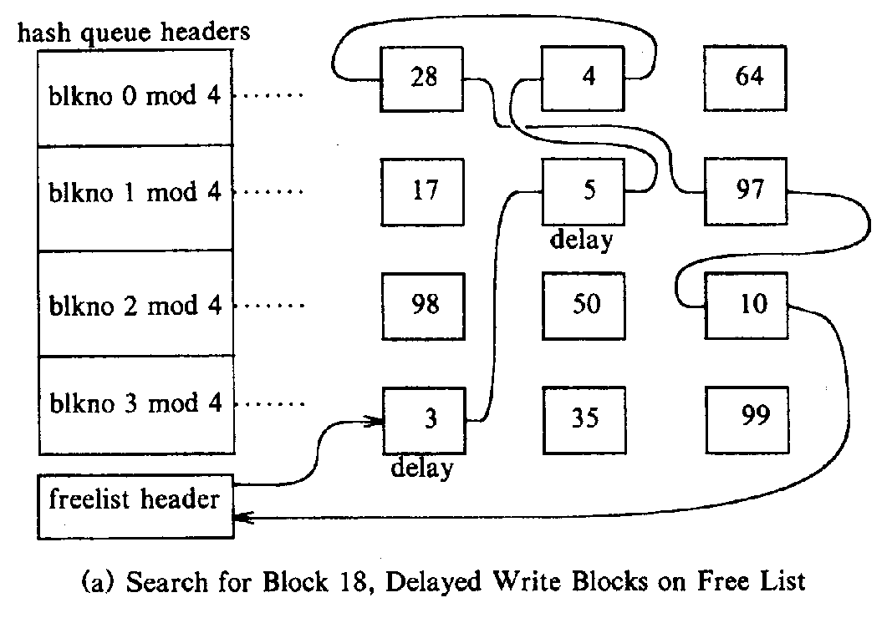
3 delayed write

Slide 15
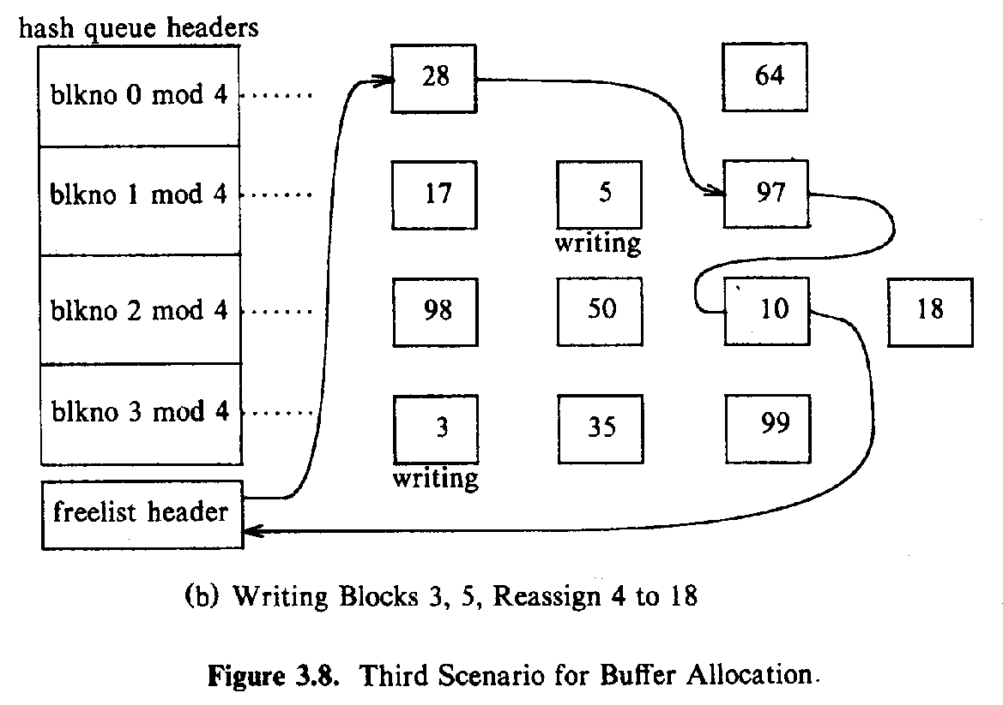
3 delayed write(Cont.)

Slide 16
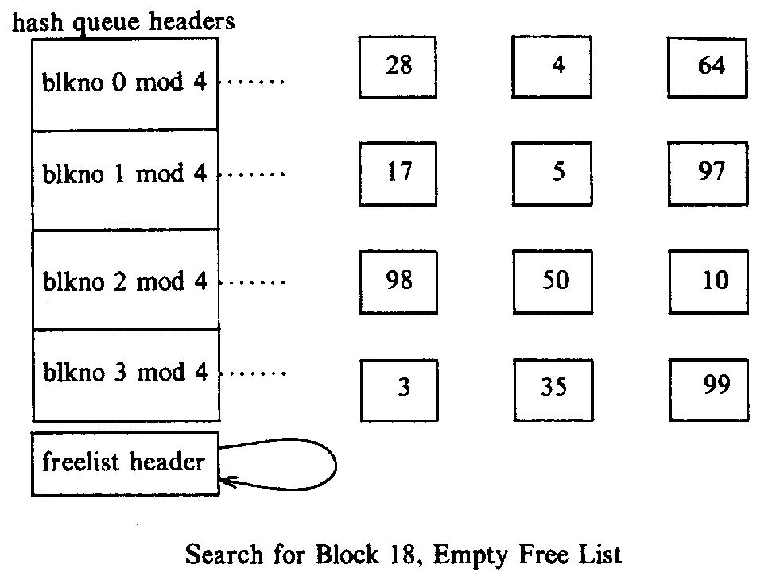
4 no free buffer

Slide 17
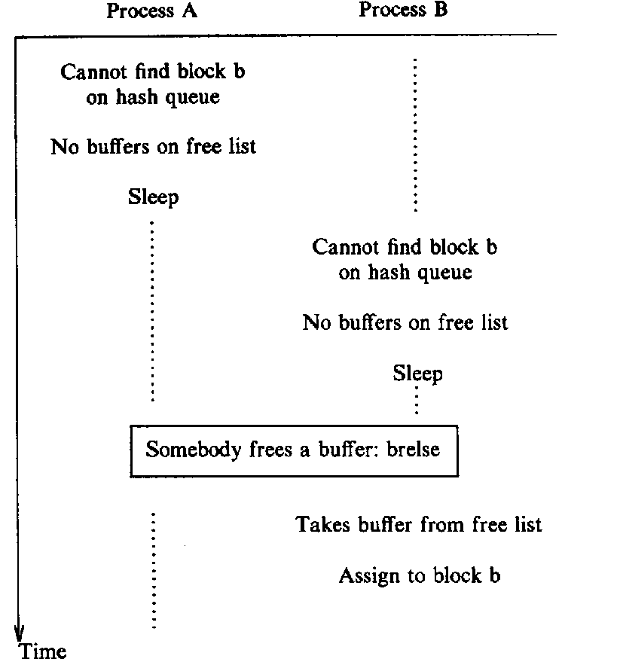
Race for free buffer
starvation ??
synchronization ??

Slide 18
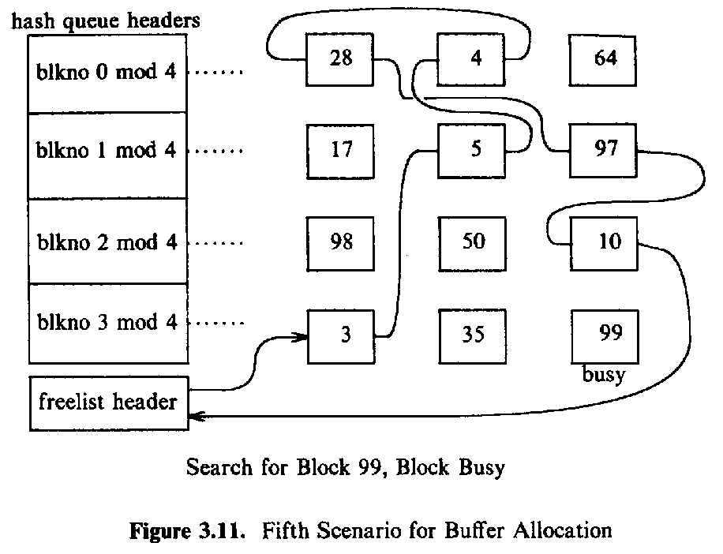
5 wait a busy buffer

Slide 19
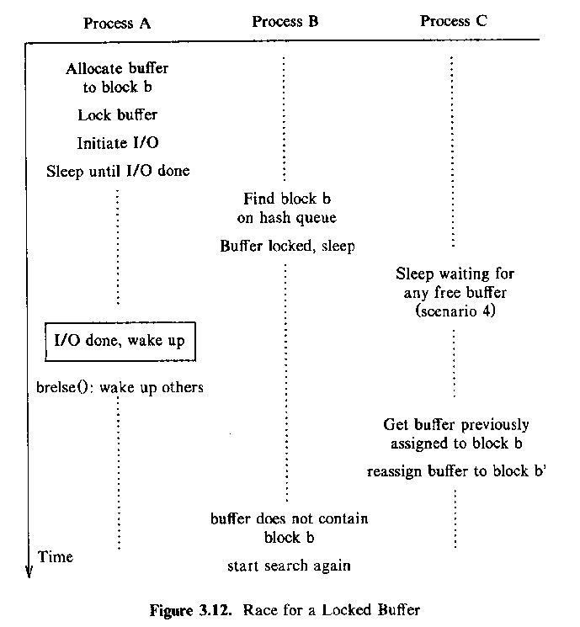
race for a buffer
Race for free buffer
starvation ??
synchronization ??

Slide 20
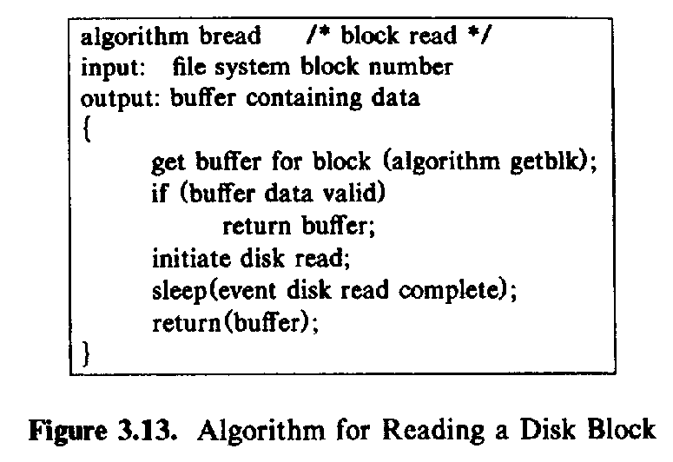

bread

Slide 21
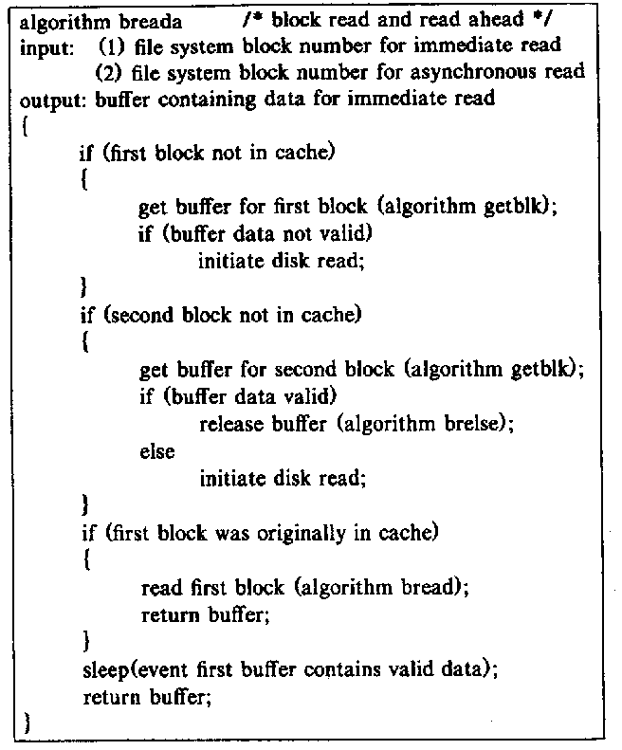
breada
Read second block asynchronously

Slide 22
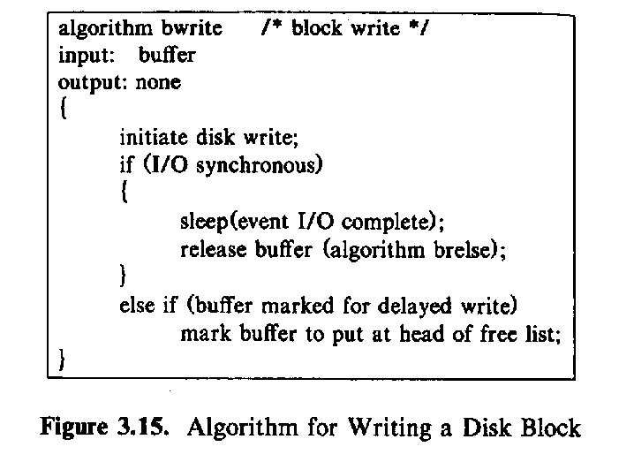
bwrite
Delayed write and asynchronous write

Slide 23
Advantages
  uniform disk access-----not care the content of the buffer: file data, inode,super block
  user program don't process data alignment
  insure file system integity
disadvantages
  system become inconsistant after crash
  extra copy

